Slide 1


Project management using Agile project management and Scrum methodology.

Slide 2
What is Agile?
Agile software development refers to a group of software development methodologies based on iterative development, where requirements and solutions evolve through collaboration between self-organizing cross-functional teams.
Agile methods or Agile processes generally promote a disciplined project management process that encourages frequent inspection and adaptation, a leadership philosophy that encourages teamwork, self-organization and accountability, a set of engineering best practices intended to allow for rapid delivery of high-quality software, and a business approach that aligns development with customer needs and company goals.

Slide 3
WHAT IS SCRUM?
Scrum is a subset of Agile. It is a lightweight process framework for agile development, and the most widely-used one.
A “process framework” is a particular set of practices that must be followed in order for a process to be consistent with the framework. (For example, the Scrum process framework requires the use of development cycles called Sprints, the XP framework requires pair programming, and so forth.)
“Lightweight” means that the overhead of the process is kept as small as possible, to maximize the amount of productive time available for getting useful work done.

Slide 4
WHAT ARE THE SCRUM REQUIREMENTS?
Scrum does not define just what form requirements are to take, but simply says that they are gathered into the Product Backlog, and referred to generically as “Product Backlog Items,” or “PBIs” for short.
Given the time-boxed nature of a Sprint, we can also infer that each set should require significantly less time to implement than the duration of the Sprint.

Slide 5
WHAT ARE THE SCRUM ROLES?
The three roles defined in Scrum are the ScrumMaster, the Product Owner, and the Team (which consists of Team members).
The people who fulfill these roles work together closely, on a daily basis, to ensure the smooth flow of information and the quick resolution of issues.

Slide 6
ScrumMaster
The ScrumMaster (sometimes written “Scrum Master,” although the official term has no space after “Scrum”) is the keeper of the process.
The ScrumMaster is responsible for making the process run smoothly, for removing obstacles that impact productivity, and for organizing and facilitating the critical meetings.
The ScrumMasters responsibilities include
Teach the Product Owner how to maximize return on investment (ROI) and meet his/her objectives through Scrum.
Improve the lives of the development Team by facilitating creativity and empowerment.
Improve the productivity of the development Team in any way possible.
Improve the engineering practices and tools so that each increment of functionality is potentially shippable.
Keep information about the Team’s progress up to date and visible to all parties.

Slide 7
Product Owner
The Product Owner is the keeper of the requirements.
The Product Owner provides the “single source of truth” for the Team regarding requirements and their planned order of implementation.
In practice, the Product Owner is the interface between the business, the customers, and their product related needs on one side, and the Team on the other.
The Product Owner buffers the Team from feature and bug-fix requests that come from many sources and is the single point of contact for all questions about product requirements.
Product Owner works closely with the team to define the user-facing and technical requirements, to document the requirements as needed, and to determine the order of their implementation.

Slide 8
Continue….
Product Owner maintains the Product Backlog (which is the repository for all of this information), keeping it up to date and at the level of detail and quality the Team requires. The Product Owner also sets the schedule for releasing completed work to customers and makes the final call as to whether implementations have the features and quality required for release.
Product Owner works closely with the team to define the user-facing and technical requirements, to document the requirements as needed, and to determine the order of their implementation.
Product Owner maintains the Product Backlog (which is the repository for all of this information), keeping it up to date and at the level of detail and quality the Team requires.
The Product Owner also sets the schedule for releasing completed work to customers and makes the final call as to whether implementations have the features and quality required for release.

Slide 9
Team
The Team is a self-organizing and cross-functional group of people who do the hands-on work of developing and testing the product.
Since the Team is responsible for producing the product, it must also have the authority to make decisions about how to perform the work.
The Team is therefore self-organizing: Team members decide how to break work into tasks, and how to allocate tasks to individuals, throughout the Sprint.
The Team size should be kept in the range from five to nine people, if possible. (A larger number make communication difficult, while a smaller number leads to low productivity and fragility.)
Note: A very similar term, “Scrum Team,” refers to the Team plus the ScrumMaster and Product Owner.

Slide 10
Sprint planning
The work to be performed (scope) during the current sprint is planned during this meeting by the entire development team.
This meeting is led by the scrum master and is where the team decides on the sprint goal.
Specific use stories are then added to the sprint from the product backlog.
These stories always align with the goal and are also agreed upon by the scrum team to be feasible to implement during the sprint. At the end of the planning meeting, every scrum member needs to be clear on what can be delivered in the sprint and how the increment can be delivered.

Slide 11
Sprint
A sprint is the actual time period when the scrum team works together to finish an increment.
Two weeks is a typical length for a sprint, though some teams find a week to be easier to scope or a month to be easier to deliver a valuable increment.
Dave West, from Scrum.org advises that the more complex the work and the more unknowns, the shorter the sprint should be.
But it’s up to your team, and you shouldn’t be afraid to change it if it’s not working! During this period, the scope can be re-negotiated between the product owner and the development team if necessary.
This forms the crux of the empirical nature of scrum. All the events — from planning to retrospective — happen during the sprint. Once a certain time interval for a sprint is established, it has to remain consistent throughout the development period. This helps the team learn from past experiences and apply that insight to future sprints.

Slide 12
Daily Scrum or Stand Up:
This is a daily super-short meeting that happens at the same time (usually mornings) and place to keep it simple.
The goal of the daily scrum is for everyone on the team to be on the same page, aligned with the sprint goal, and to get a plan out for the next 24 hours.
A common way to conduct a stand up is for every team member to answers three questions in the context of achieving the sprint goal:
What did I do yesterday?
What do I plan to do today?
Are there any obstacles?

Slide 13
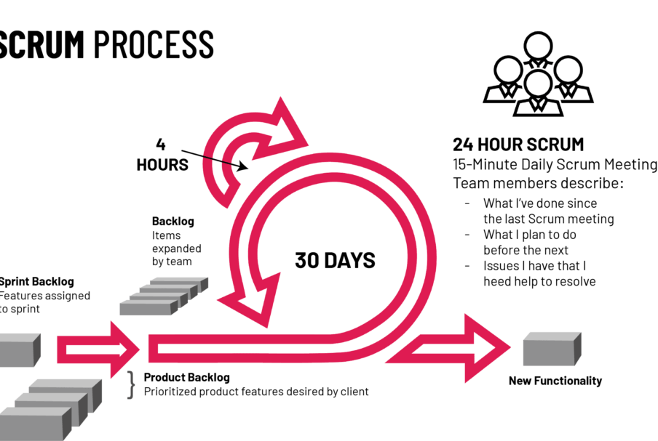
Scrum Process

Slide 14
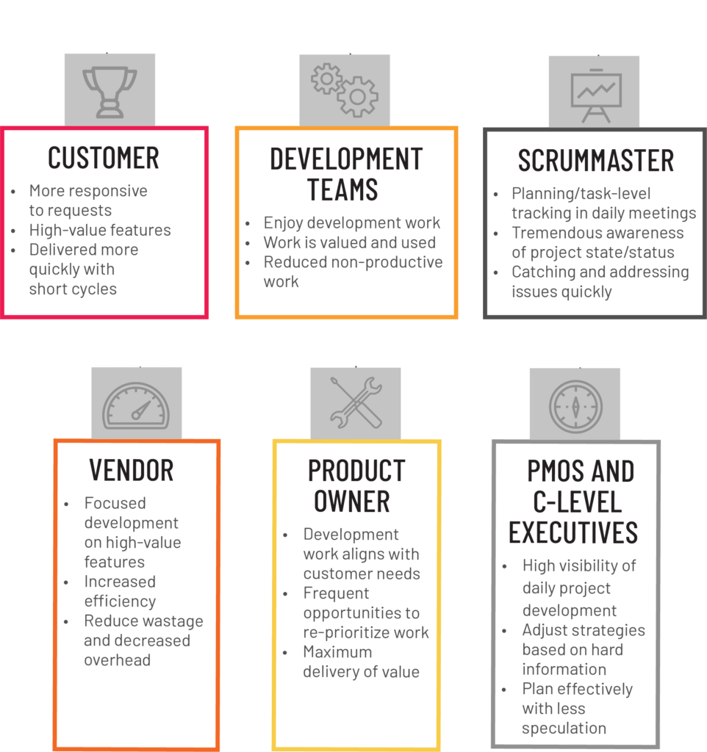
WHAT ARE THE BENEFITS OF AGILE Scrum?

